Slide 1
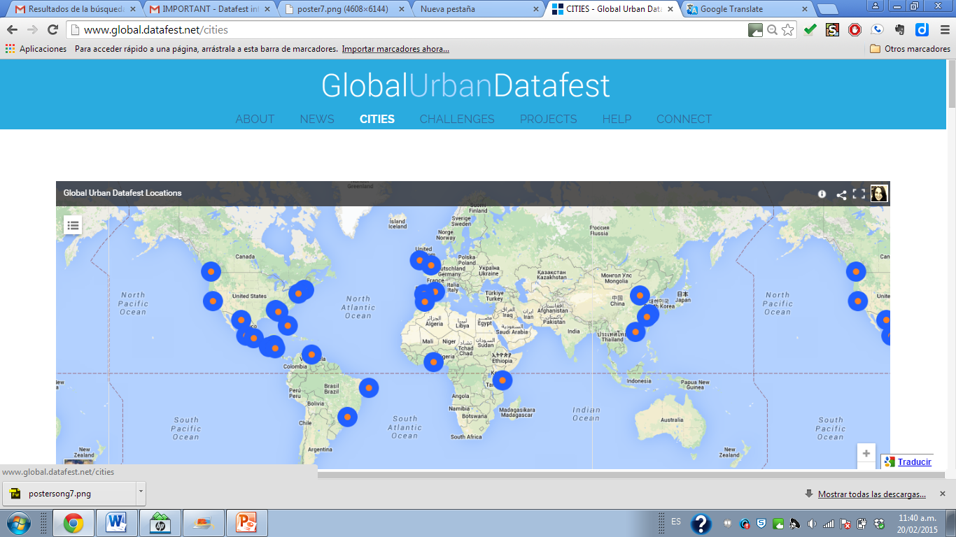
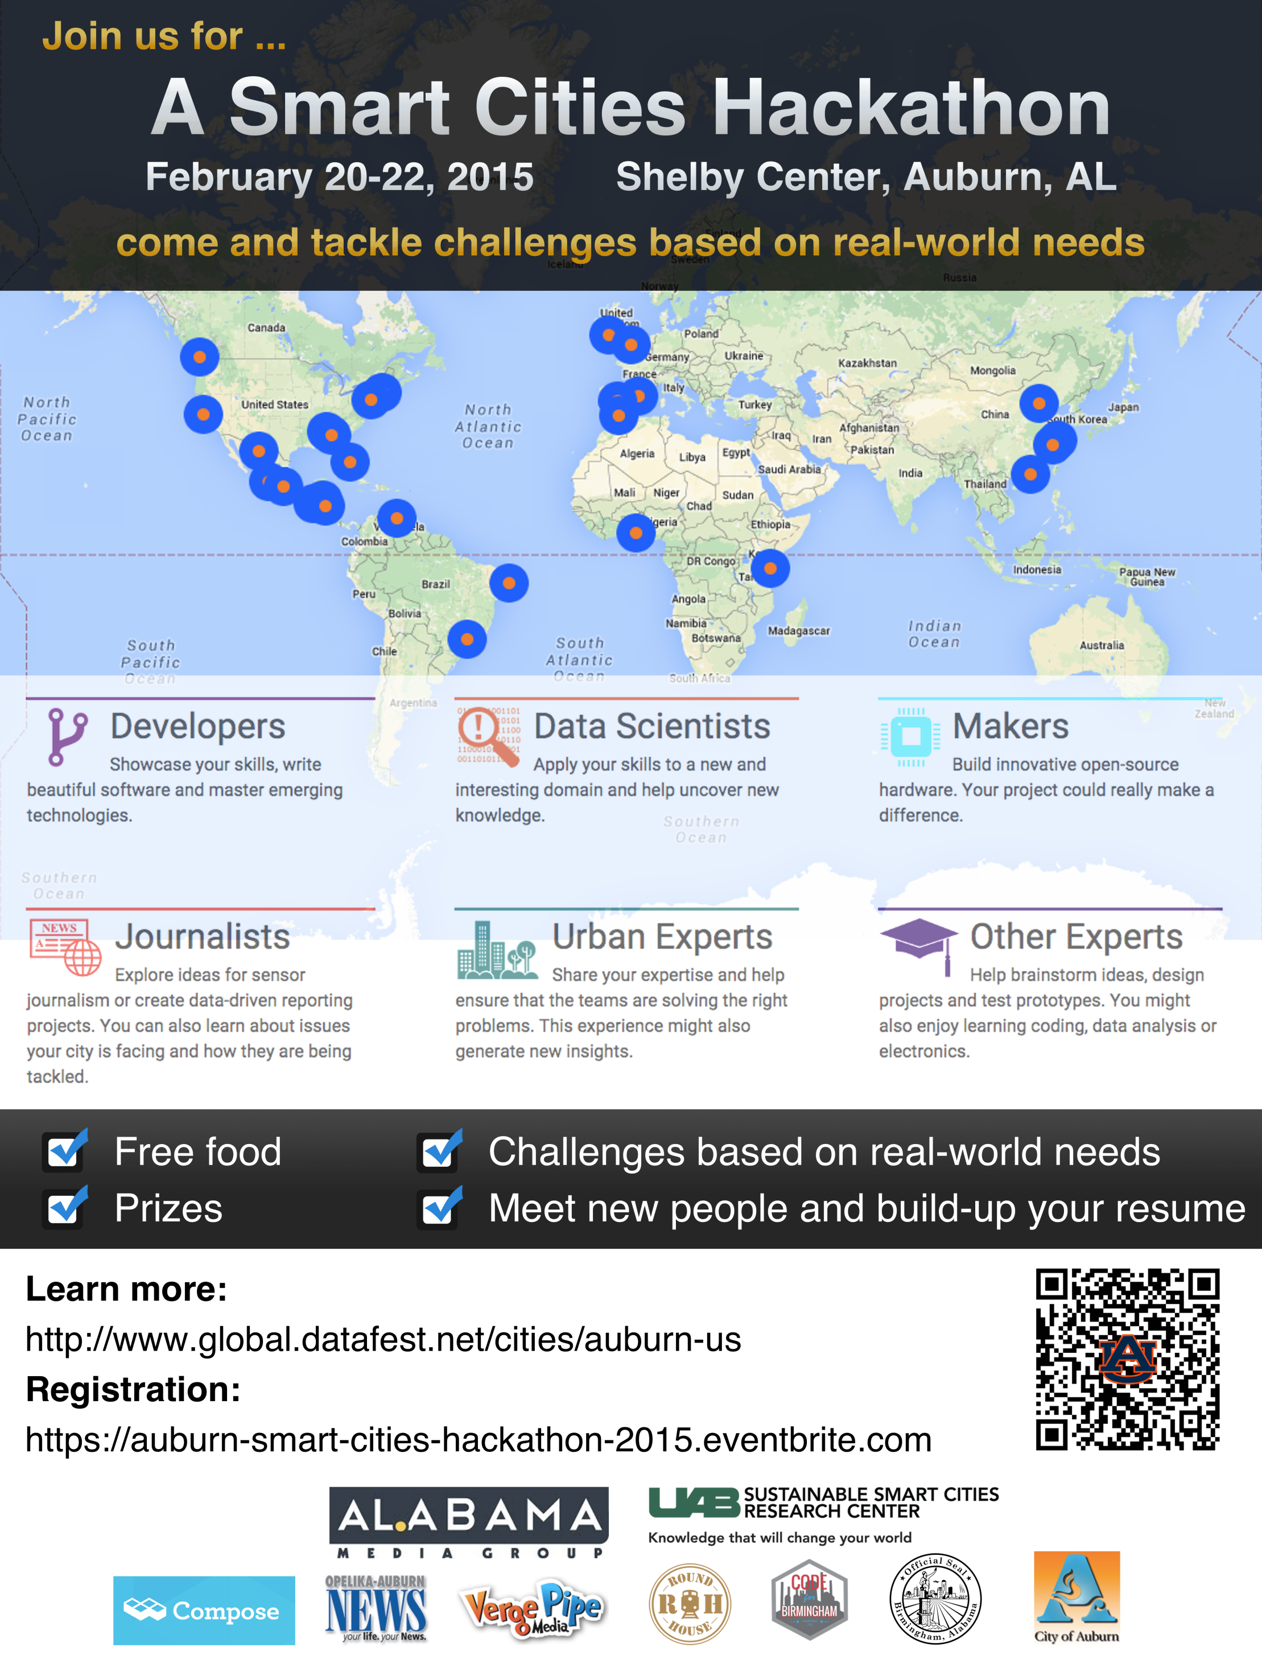


AUBURN, AL

Slide 2
AUBURN, AL
Agenda
Introduction
Global Datafest Overview
Sponsors
Challeneges
Schedule
Mentor
Rules
What to Bring
Locations
Raffle
IBM Option
Sponsors Presentation
Judging Criteria
Judges
Conclusion

Slide 3
WHAT IS THIS?
Make An Impact!

Slide 4









SPONSORS & PARTNERS
Sponsors
Partners

Slide 5
AUBURN, AL
Challenges
Traffic tracking/alert app
Parking app
Green app
Fresh Food Access App
Tapestry Report
Land Bank
Mobile Food Market
Trail System Companion App
Household Travel Survey
Government Data Converter Tool

Slide 6
AUBURN, AL
Hackathon Process & Schedule
Friday 5:40 PM: Check-in (Shelby Center 3129) & Dinner 6:10 PM: Inception + Sponsor Intro 7:00 PM: Make friends / Team Formations / Project Planning 11:59 PM: Finish the team page on the website to enter the Pi raffle!
Saturday 9:00 AM: Breakfast & Coffee 9:30 AM: Start Hacking, Hustling & Designing 12:00 PM: Lunch 3:00 PM: Call for Help (Mentor Time) 5:30 PM: Status Reports/Project Page on the Website 6:30 PM: Dinner 9:00 PM: Hack, Hydrate, Eat. Sleep!
Sunday 9:00 AM: Breakfast & Coffee 9:30 AM: Hack, Hack, Hack 10:30 AM: Call for help (Mentor Time) 12:00 PM: Lunch 4:30 PM: Final Presentations/Demos; Judging; Dinner

Slide 7
AUBURN, AL
Call for Help
Mentor
Dr. Jeffrey Overbey
Software Engineering professor at Auburn University
Song Gao
Hacker
SAT 3:00 PM
SUN 10:30 AM
Organizing Team
Song Gao. PhD candidate of Auburn University
Robert Skelton. Senior student, President of the Linux Club at Auburn University
Ana Maria Carrano. Journalist, Knight Fellow 2014 at Stanford University

Slide 8
AUBURN, AL
Rules
Coding
Code must be new (may use existing tools and libraries)
Code must be written during the event.
Deadlines
Fri 11:59 PM Finish the team page on the website to enter the Pi raffle!
Sat 6 PM Project page creation
Sun 4:30 PM: Final Presentations
Copyright
Participants own the copyright to their code. Still, it is wonderful to share your code and data and we would love it if you open-source it.
Each participant is solely responsible for any unauthorized use of third party intellectual property. Please note that the projects submitted for global recognition must be open-sourced.
Language
English

Slide 9
AUBURN, AL
What to Bring/Locations
Laptop
Charger
Headphones if you work better
AU_Wifi for students/staff
Guest Wifi codes for non students
Water bottle
Shelby 3129 and Study Room
Other Shelby Rooms

Slide 10
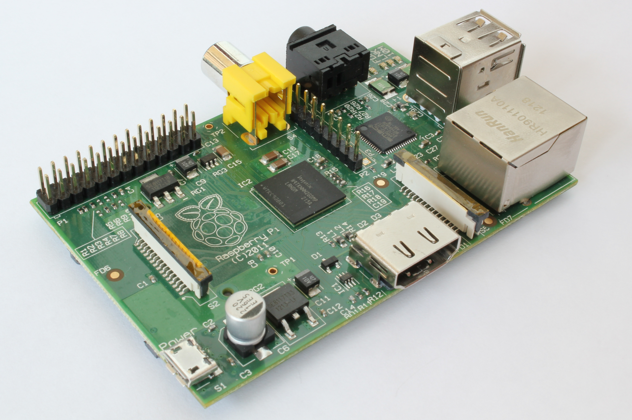
AUBURN, AL
Raffles
15 Raspberry Pi’s to give away via Raffles!

Slide 11
AUBURN, AL
Organizers Presentation

Slide 12
AUBURN, AL
Judging Criteria
20% Usefulness
Is the project based on Alabama cities real needs? How relevant is it?
20% Innovation
Is there existing projects that accomplished the same goal? Does the project provide a better/faster/clearer way to attack the problem than others? Does it tackle a problem with a new angle / on a bigger scale / on a higher level?
20% Usability. User experience
Is it usable, intuitive and clear? Easy to use?
10% Technical Difficulty
Too easy? --- Very Difficult?
15% Functionality
How functional the prototype implementation is for the proposed idea and goal? The project prototype should not be merely an idea or user interface, but should be functional to some extent.
15% Scalability
The ability to adapt the project for wider use. The project should be adaptable to other locations, but not necessarily useful to large percent of population.

Slide 13
AUBURN, AL
Judges
Don Crow, founder of Verge Pipe Media, an advertising and social media start-up.
Song Gao (PhD candidate of Auburn University and organizer)
Christopher Graff, the GIS Manager within the IT Department at the City of Auburn.
John Walker, Web Coordinator of the Opelika-Auburn News.
Dr. Jeffrey Overbey, a Software Engineering professor at Auburn University and mentor of the hackathon.

Slide 14
AUBURN, AL
Conclusion
Make friends
Team Formations
Project Planning
Website must be made tonight!
Must be complete by 5:30PM tomorrow!
Meet back here at 9AM for breakfast
Use hashtags: #alhack (local) #smartcityhack (global)

